Slide 1
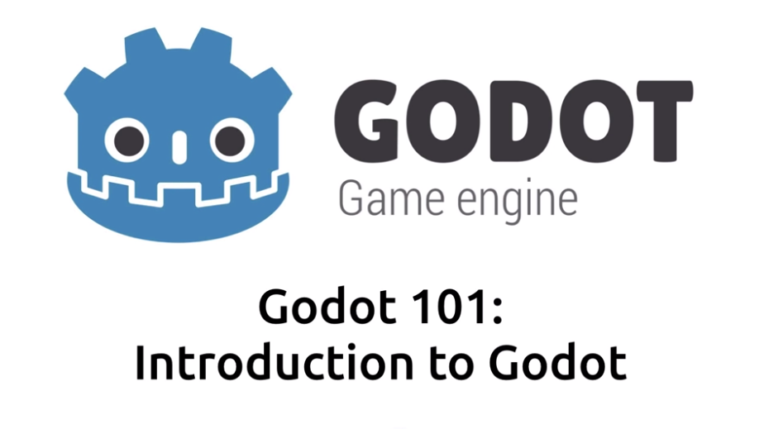


Slide 2
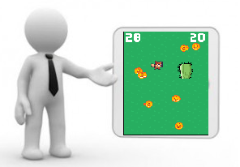
Why its good to learn some Game Tools
It gives you advantage over other candidate
“Sell Yourself With Samples”
Great way for making a demo and show casing your talent
Show you are a enthusiastic, motivated, fast and self learning individuals
Relatively new for formal education

Slide 3
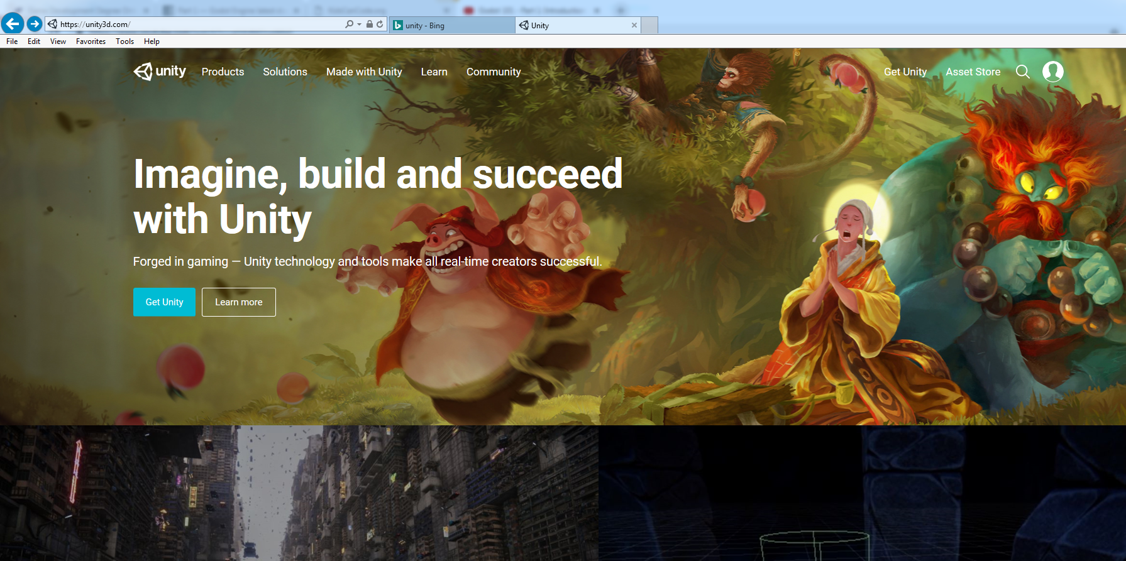
Unity is a 100 pound Gorilla
in Game industry

Slide 4
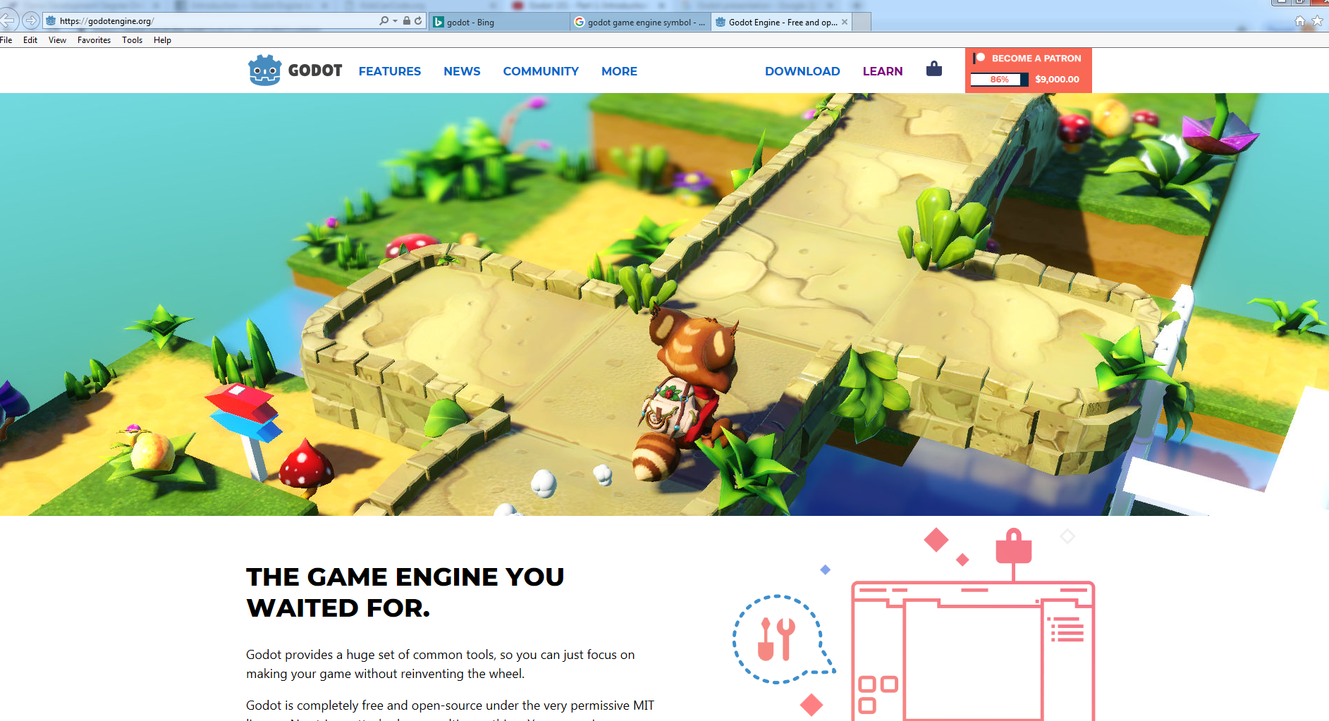

Slide 5




Vs
Primarily made for 2D development
Primarily made for 3D development

Slide 6

Vs
Not Completely free
Free games should be made
with unity splash screen
Once you start making money
You need to pay the royalty
Completely free

Slide 7


Vs
Cross Platform
Unity crashes on Unix in about 5 min

Slide 8
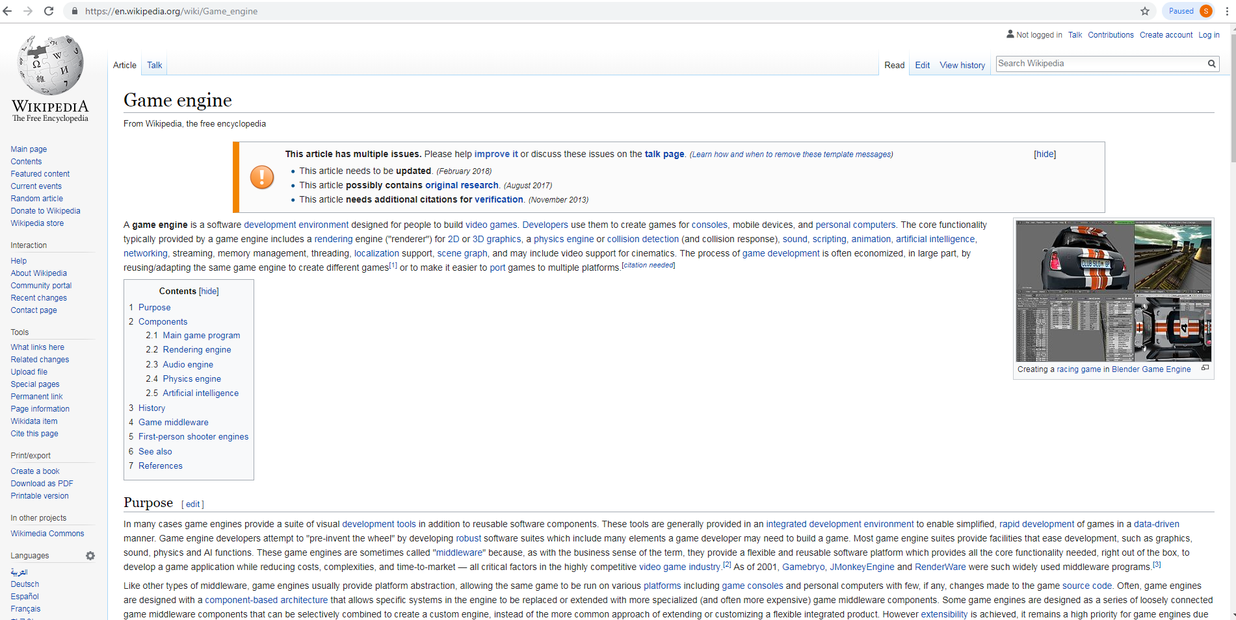

Slide 9


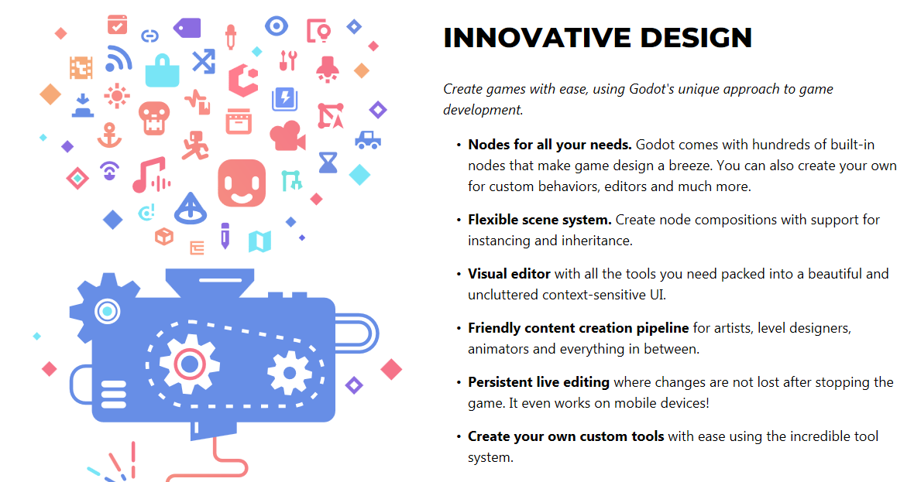

Slide 10
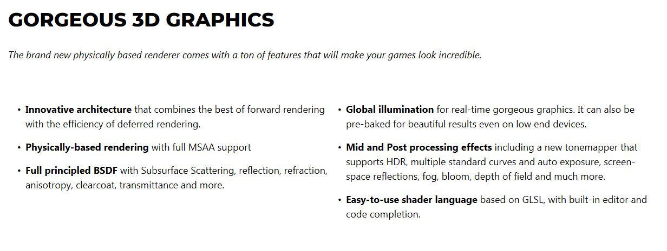

Slide 11
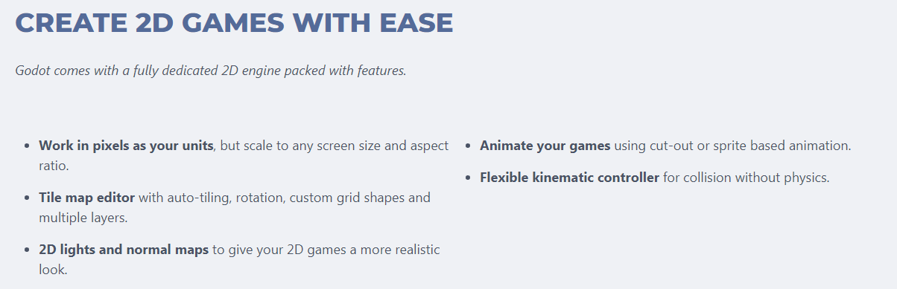

Slide 12
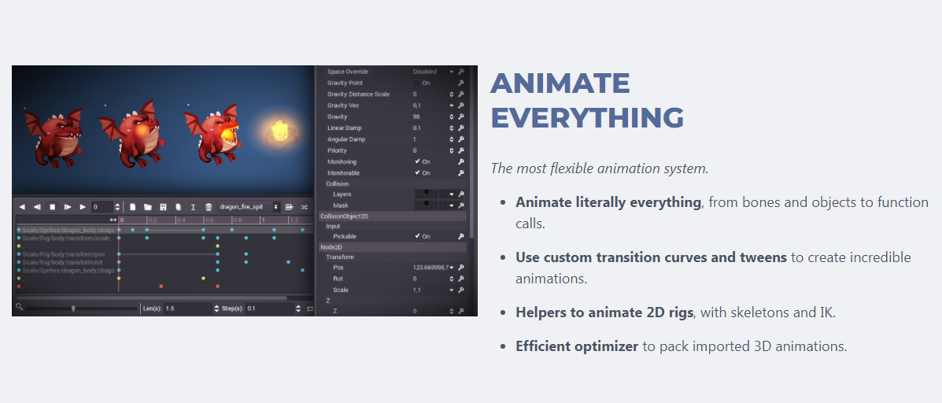

Slide 13
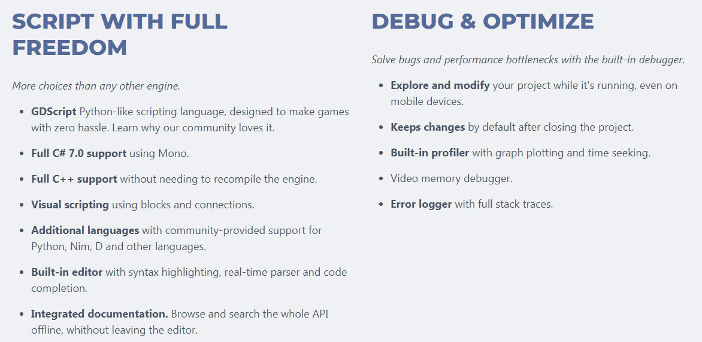

Slide 14
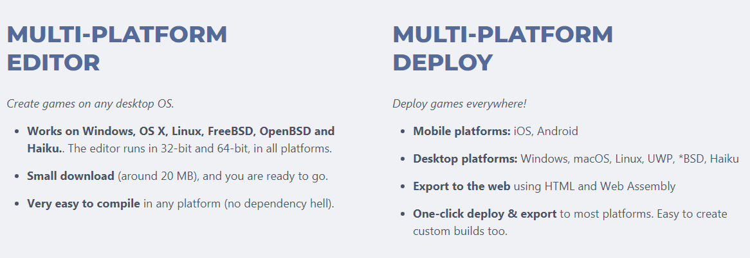

Slide 15
General Advice
Don’t feel discouraged if you don’t get something at first
Goal is not to become expert in 8 hours lecture
Repetition is the key
The more you use Godot the more easy it will feel
If you do repetitively, you will know how much better you understand from the first time.
Code yourself. Resist the temptation to copy and paste. Write the code
Keep your first few project small
For first few project follow some books or online tutorial before jumping into designing your own
So finish basic projects before jumping into better ideas, that come into your mind. Keep the ideas aside for a while
After every game you make, give yourself time, to absorb the contents before you jump to the new game.
Enjoy the process

Slide 16
Some Sample Games made using GoDot
https://www.youtube.com/watch?v=UTAeDoRIHaA
Free Game Engine.
https://www.youtube.com/watch?v=nT_9-p1-1cU

